Slide 1
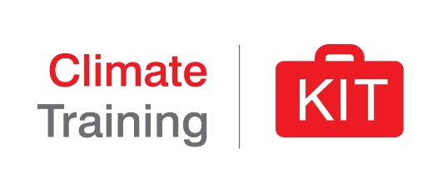
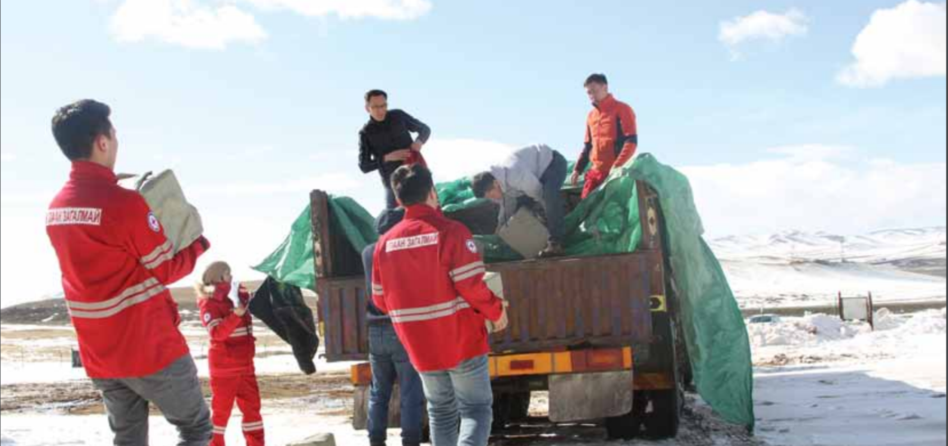
Early Warning Early Action
The steps to make it happen
Mongolia, Early Action for Dzud, February 2018
Notes:
This module presents a case for a focus on Early Warning Early Action (EWEA) in the Red Cross Red Crescent Movement (RCRC) for improved Climate and Disaster Risk Management.
Image: Early Action for Dzud, taken by the Mongolia RC in Feb 2018.
Note to the facilitator – for this topic, different games are most successful to provide concrete understanding of making use of climate information for humanitarian decisions
See the games section for this module.

Slide 2
Session summary
Important links to Preparedness for Effective Response (PER)
National and community early warning systems
Forecast-based Financing as a mechanism for early warning early action
Strong engagement with national DRM and other risk management strategies (including social protection)
Photo: Climate Centre / Denis Onyodi
Notes:
This session aims to show how a National Society to achieve an optimal level of Early Warning Early Action*, by aiming for the following:
Preparedness as an integral part of their Disaster Risk Management processes.
Engaging in and supporting regional, national and community level early warning systems.
When possible establish Forecast-based Financing mechanisms.
Having strong engagement with Government DRM processes at all levels including social protection.
Details on each of these follow in the final part of this presentation.
*As described in previous session: EWEA = Routinely taking humanitarian action before a disaster or health emergency happens, making full use of scientific and traditional information on all timescales

Slide 3
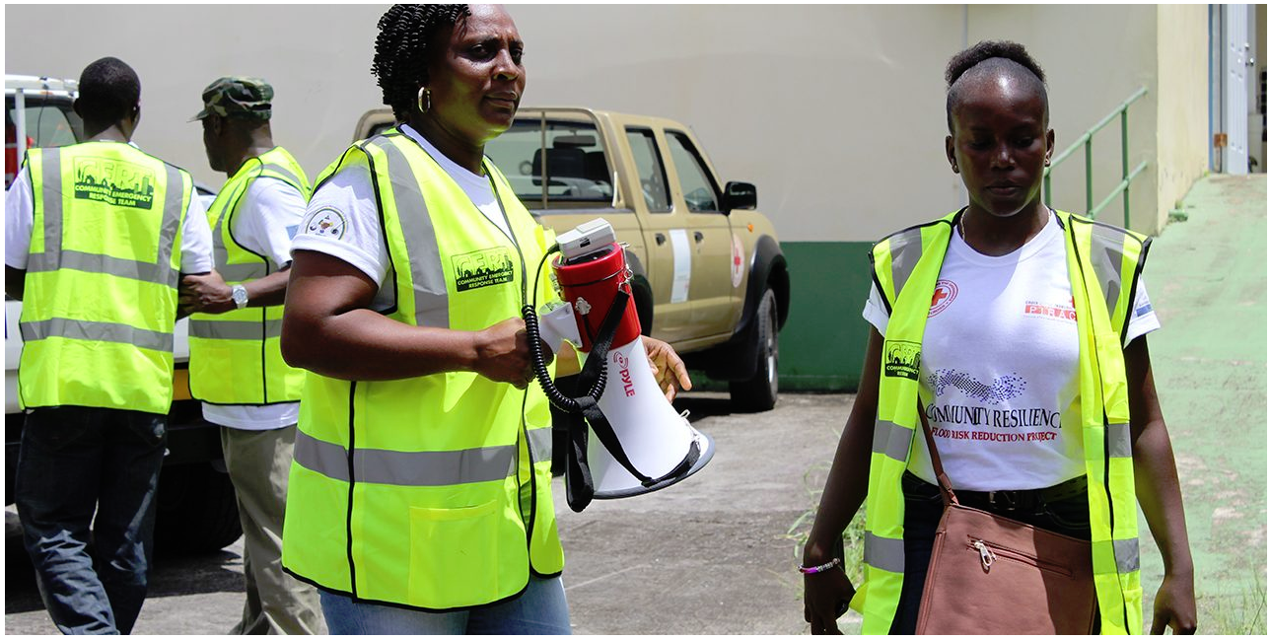
What is an Early Warning System?
“An integrated system of hazard monitoring, forecasting and prediction, disaster risk assessment, communication and preparedness activities, systems and processes that enables individuals, communities, governments, businesses and others to take timely action to reduce disaster risks in advance of hazardous events.” (United Nations)
Notes:
A United Nations’ working group has agreed this definition for Early Warning Systems.
“An integrated system of hazard monitoring, forecasting and prediction, disaster risk assessment, communication and preparedness activities, systems and processes…
…that enables individuals, communities, governments, businesses and others to take timely action to reduce disaster risks in advance of hazardous events.”
The critical aspects of this definition are highlighted in red and worth repeating.
(The four components of an EWS will be covered in following slides.)
There are different types and approaches of EWS: Community-based Early Warning Systems, being one of the key activities of the Red Cross Red Crescent.
Definition: United Nations (2016). Report of the Open-ended Intergovernmental Expert Working Group on Indicators and Terminology Related to Disaster Risk Reduction (OIEWG) (A/71/644), adopted by the General Assembly on 2 February 2017 (A/RES/71/276) https://www.preventionweb.net/files/50683_oiewgreportenglish.pdf

Slide 4
What is an effective Early Warning System?
An effective Early Warning System should be:
end-to-end
people-centred
and it should consider the nature of multiple hazards occurring simultaneously, cascading or cumulative over time.
Who should it reach?
Photo: Climate Centre / Denis Onyodi
Notes:
The same group agreed an effective early warning system is:
End-To-End: An end-to-end EWS is a complete set of components that connects those who need to hear messages to others who compile and track the hazard information of which messages are composed.
People-Centred: A people-centred EWS empowers individuals and communities threatened by hazards to act jointly plan, to analyse risks, identify best ways to communicate/understand warnings and to make sure there is sufficient time and in an appropriate manner to reduce the possibility of personal injury and illness, loss of life and damage to property, assets and the environment.
Multi-hazard is defined as “(1) the selection of multiple major hazards that the country faces, and (2) the specific contexts where hazardous events may occur simultaneously, cascadingly or cumulatively over time, and taking into account the potential interrelated effects. Hazards include (as mentioned in the Sendai Framework for Disaster Risk Reduction 2015–2030) biological, environmental, geological, hydrometeorological and technological processes and phenomena”.
Audience Interaction:
Ask participants who such a EWS should aim to reach.
Answers to complement:
Inclusive system, for marginalized groups, women and girls, ensuring it reaches all people including those at “the last mile”, including the most vulnerable people and most remote communities.

Slide 5
Components of an Early Warning System
Risk knowledge
Monitoring and warning systems
Preparedness and response capacities
Warning dissemination and communication
Notes:
This slide shows the four main components of any Early Warning System (EWS).
Risk knowledge: Systematically collect data and undertake risk assessments
Monitoring and warning services: Develop hazard monitoring and early warning services
Warning dissemination and communication: Communicate risk information and early warnings
Preparedness and response capability: Build NS and community preparedness and response capabilities
To analyze the specific task, activities, resources that are necessary to establish an EWS, the World Meteorological Organization (WMO) has updated the EWS checklist, this included the feedback from IFRC and the Climate Centre.
More information and case studies can be found in the readings for this module including:
The WMO Early Warning System checklist:
https://library.wmo.int/doc_num.php?explnum_id=4463
Early Warning Systems Toolkit, developed by the Caribbean Disaster Emergency Management Agency (CDEMA), IFRC and the United Nations Development Programme (UNDP) in 2018.
https://media.ifrc.org/ifrc/2018/08/29/early-warning-systems-toolkit/
Community EWS Training Toolkit – Field Guide, developed by the IFRC
https://www.preparecenter.org/resources/ifrc-community-early-warning-systems-toolkit

Slide 6
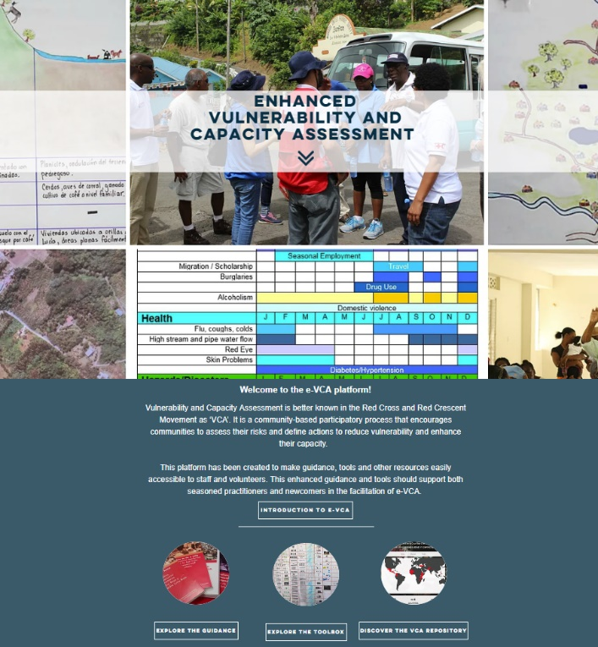
1. Risk knowledge
An effective EWS considers the dynamic nature of hazards, vulnerabilities and exposure within a specific location.
… some tools are designed to also identify changing risk patterns:
Secondary data review
Seasonal calendar
Community mapping:
Spatial map
Hazard/risk/vulnerability map
Capacity and resource map
Historical calendar
Hazards/vulnerability/capacity matrix
→ See 'Enhanced Vulnerability and Capacity Assessment' online: www.ifrcvca.org
Notes:
Risk Knowledge: Systematically collect data and undertake risk assessments. In the E-VCA there is a lot of guidance on how to undertake local risk assesments, which include climate lenses. In module 2c in this KIT, we have include all relevant materials, explaining how these Participatory Risk Assessments can be facilitated with good inclusion of climate concerns.
An effective EWS considers the dynamic nature of hazards, vulnerabilities and exposure within a specific location.
Risk assessments and maps help to motivate people, priorities early warning system needs and guide preparations for disaster prevention and responses.
Questions to consider:
Are all hazards and multi-hazard well known?
Are exposed elements well known? - population, assets, infrastructure etc
Are vulnerability conditions well known? - who/what is more vulnerable to a given hazard?
What are the patterns and trends for exposure and
vulnerability?
Are risks maps, historical disaster data available?
Who is the most affected? - which vulnerable groups are more affected and why?
Who are the relevant stakeholders involved in risk
analysis and information management?
Checklist for Risk Knowledge includes:
Organizational arrangements established: Who does what in the risk assessment process? What are the resources to conduct it and to keep it updated?
Hazards identified: identify the priority hazards to establish an EWS - it is important to consider the multi-hazard interaction*
Community vulnerabilities and exposure analyzed: this can be done at different geographical levels - National - regional - local. Who is more exposed to which hazard? Who is more vulnerable to which hazard?
Risks assessed: it is clear what are the risks that a community face. What are the potential disaster impacts that population, assets, infrastructure, livelihoods and the environment could suffer when there is a disaster?)
Risk Information is consolidated and stored and accessible in a safe place and with a clear plan to be updated.
Questions for Risk Knowledge include:
Are all hazards and multi-hazard and related threats well known?
What are the risks and patterns and trends for exposure and vulnerability?
Are risks maps, historical disaster data available?
Who are the relevant stakeholders involved in risk analysis and information management?
Are their roles and responsibilities identified?
Are the exposure, vulnerability and capacity well understood and assessed? Including:
exposed elements including population, assets, infrastructure etc
vulnerability conditions including who and what are more vulnerable to a given hazard and why
vulnerable people and groups most likely to be affected and why
capacities of all people and communities at risk
capacities of agencies and entities who prepare and respond to hazardous events
*Multi-hazard [or a multi-hazard approach]: An approach that considers more than one hazard in a given place (ideally progressing to consider all known hazards) and the interrelations between these hazards, including their simultaneous or cumulative occurrence and their potential interactions. Note that to progress from hazard potential to risk, a multi-hazard approach should also consider the dynamic nature of vulnerability, for instance following a primary hazard event, exposed assets will have an increased vulnerability to subsequent hazards. http://www.interactinghazards.com/defining-multi-hazard
The Enhanced Vulnerability and Capacity Assessment (EVCA) and the Community-based Health and First Aid (CBHFA) are the main community assessment tools in the Movement – in CBHFA it is “module 3” in the manual.
Much of the community assessment tools are compiled online in the Enhanced Vulnerability and Capacity Assessment at www.ifrcvca.org
Compared to the former VCA toolbox, several tools in the EVCA are revised to also guide users in identifying changing risks and lkely climate change effects.
FACILITATOR: you may like to use the video from the Philippines on integrating climate aspects in three key EVCA tools "Updated participatory tools for community risk assessment" here: https://vimeo.com/207315447

Slide 7
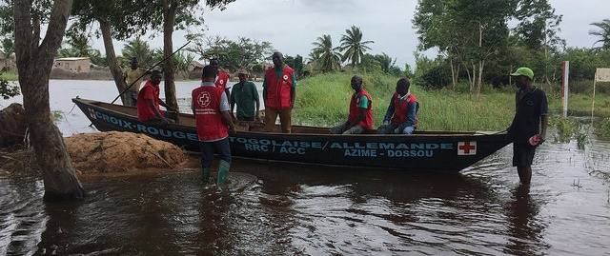
1. Risk knowledge
When doing a risk analysis it is critical to look at the intersection of the effects of this hazard with any long term change processes related to climate change.
Preparing from what happened in the past it is no longer sufficient
Notes:
When doing a risk analysis it is critical to look at the intersection of the effects of this hazard with any long term change processes related to climate change such as sea level rise.
Preparing from what happened in the past it is not sufficient!!!

Slide 8
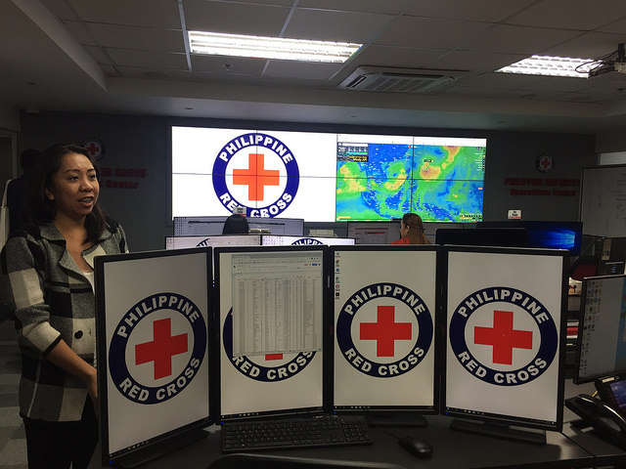
2. Monitoring and warning services
Monitoring Scientific and traditional indicators is essential for effective monitoring and warning systems
Questions to consider:
Which are the best forecasts that can be used?
Which are the indicators that should be monitored?
Are the right indicators of the hazard being monitored?
Should various indicators be monitored in parallel to be able to issue a warning?
“National Hydro-Meteorological Services are usually the only agency mandated officially to issue warning messages”
Philippines Red Cross Operations Centre, 2018
Notes:
Monitoring and warning services: Develop hazard monitoring and early warning services
Monitoring and warning system lies at the core of the EWS.
It requires detection, monitoring, analysis and forecasting of the hazards and possible consequences
It involves the development of hazard monitoring and warning services at all level from national to sub-national to community.
There must be a sound scientific basis for predicting and forecasting hazards and a reliable forecasting and warning system that operates 24 hours a day.
Continuous monitoring of hazard parameters and precursors is essential to generate accurate warnings in a timely fashion. Risk data must be part of monitoring and warnings systems.
Warning services for different hazards should be coordinated where possible to gain the benefit of shared institutional, procedural and communication networks.
Hazard monitoring can include, for example, river gauges for floods and forecasts for extreme rain or drought.
Checklist for Monitoring and Warning Services includes:
Institutional mechanisms established
Monitoring system developed
Forecasting and monitoring systems established
Questions for Monitoring and Warning Services include:
Which are the best forecast that can be used in the EWS?
Which are the indicators that should be monitored? e.g wind speed, cyclone tracks, river levels, food prices etc.
Are the right indicators of the hazard being monitored? should various indicators be monitored in parallel to be able to issue a warning?
Is there enough data to issue accurate and timely warnings? Which risk data should be included in the monitoring?
Forecast skill definition: Refers to the superiority of a forecast over a simple historical baseline of past observations. It tells us if a forecast is good predicting or if usually or always gets it wrong.
For more information about understanding forecasts see Forecasts for Early Action module
For more guidance on how to partner with your National Met Service see Climate Centre guidance in the relevant reading section of this module.

Slide 9
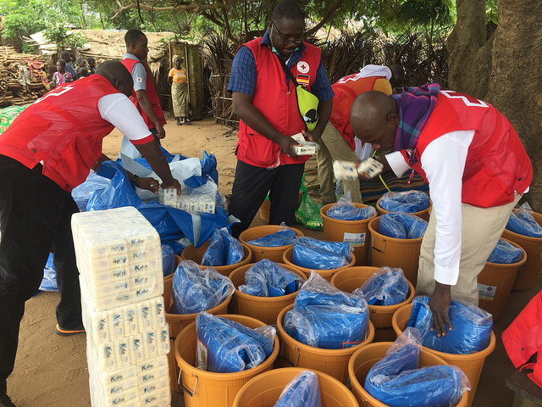
3. Preparedness and response capacity
Timely Early Warning information is a key to activate effectively early action and preparedness for response plans, this should be done at national, regional, local and community level.
Questions to consider:
Are Disaster Risk Management plans and
contingency plans regularly updated?
Are roles and responsibilities clearly defined?
Are the plans feasible and adaptable?
Is there good institutional capacity to act early and
respond? (e. human, financial resources, skills)
Are there coordination systems to facilitate
early actions and response?
Are the most at risk and vulnerable communities
ready to act upon to the warning message?
Togo Red Cross, 2017. Early Action plans activated based on warning information
Notes:
“A community that is able to manage their risks and prepared for response using effective early warning information is a RESILIENT COMMUNITY”
Building NS and community preparedness and response capabilities is key. An effective EWS would guarantee that disaster risk management institutions and communities at risk have the capacities to act when there is an early warning.
Systematic education and disaster risk reduction programs are essential to enable effective response capacity. It is essential that disaster management plans (and contingency plans) are in place and are well practiced and tested.
Checklist for Preparedness and Response Capacity include:
• Disaster preparedness measures, including response plans, are developed and operational.
• Public awareness and education campaigns are conducted and evaluated.
• Response plans are tested and evaluated.
Questions for Preparedness and Response Capacity include:
Are Disaster Risk Management plans and contingency plans regularly updated?
Are roles and responsibilities clearly defined?
Are the plans feasible and adaptable?
Is there good institutional capacity to act early and respond? (e. human, financial resources, skills)
Are there coordination systems to facilitate early actions and response?
Are the most at risk and vulnerable communities ready to act upon to the warning message?

Slide 10
3. Preparedness and response capacity
Examples for Response Capacity
Actions that aim at prevent and mitigate: e.g. vaccinations, clearing drainage, early harvest, evacuation.
Actions that aim
at prepare for responding effectively: e.g. prepare evacuation shelters, vehicles with fuel, communications systems ready
Actions to respond and recover effectively: e.g. distribution of shelter kits, hygiene items, food etc.
Togo Red Cross, 2017. Early Action plans activated based on warning information
Notes:
Please note that cash transfer could be an action that will enable the implementation of measures across the early action to response and recovery timeframe.

Slide 11
4. Warning dissemination and communication
A people-centred EWS ensures that those at risk receive early warning information that is clear, understandable and actionable in a timely manner.
Multiple channels of communication within reach of those at risk should be used.
Questions to consider:
Do warnings reach all those at risk and most vulnerable?
Are the risks and warnings understood?
Is the warning information clear and useable?
Is there enough time between the warning and the disaster to take early actions?
Is the warning reaching the most remote areas?
Notes:
Warning dissemination and communication
Early warning information should be packaged in languages and ways that are understood by those at risk.
Multiple channels of communication within reach of those at risk should be used: Social media, radio, TV, in person (using megaphones and/or other tools)
Early warning information should reach as many people as possible
Dissemination and Communication: Communicate risk information and early warnings
• Are impact-based early warnings communicated effectively to prompt action by target groups?
Check list
Organizational and decision-making processes institutionalized and operational
Effective communication systems and equipment installed and operational
Warning messages recognized and understood
Questions to consider:
Do warnings reach all those at risk and most vulnerable?
Is the warning reaching the most remote areas?
Are the risks and warnings understood?
Is the warning information clear and useable?
Is there enough time between the warning and the disaster to take early actions?

Slide 12
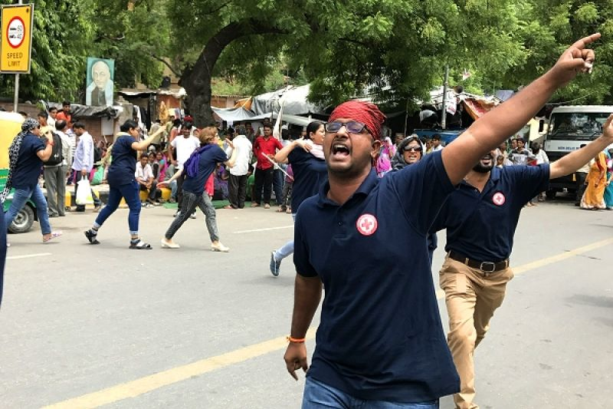
4. Warning dissemination and communication
Example communication longer term trends:
Heat Wave Awareness “Flash Mobs” in India
But note again “National Hydro-Meteorological Services are usually the only agency mandated officially to issue short term warning messages”
Photo: India Red Cross Society heatwave flash mob in Delhi, 2018
Notes:
Indian Red Cross Society (IRCS) staff and volunteers worked with the Climate Centre to design messages about how to prepare for heatwaves.
The IRCS team was trained in how to deliver the information through synchronized song and dance “Flash Mob” performances.
A total of 8 heatwave flash mobs were held over four days reaching an estimated 1,600 people. The Director of the International Airport in Delhi picked it up and asked for the flash mob in his departure halls.
This allowed for key messages to be spread quickly and be remembered verbatim.
We have multiple examples of collaborations with NSs where different ways to communicate climate risks were designed. You can read more about in the 3c. communication module of this KIT.
For the india flashmob, more info can be found at: https://www.climatecentre.org/news/866/turn-down-the-heat-wave-red-cross-flash-mobs-in-india

Slide 13
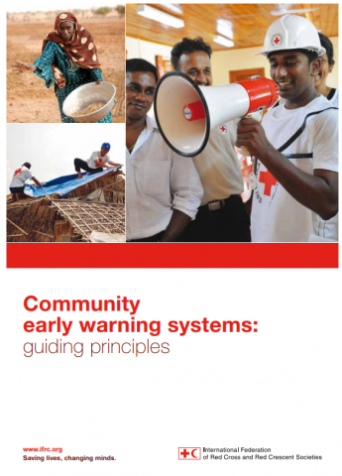
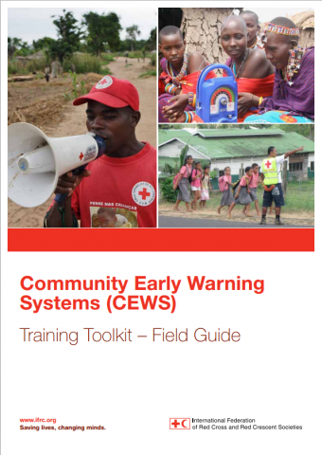
Community Early Warning Systems
It may be appropriate for a National Society to accompany a community as they develop a Community Early Warning System (C-EWS).
To support this work IFRC has developed resources including Community Early Warning Systems Guiding Principles and a Training Toolkit – Field Guide.
Notes:
Following the outcomes of a risk assessment or at the invitation of a community, it may be appropriate for a National Society to accompany a community as they develop a Community Early Warning System (C-EWS).
To support this work IFRC has developed resources including Community Early Warning Systems Guiding Principles and a Training Toolkit – Field Guide which are key references for this section.
You can find details of these resources in the reading list for this section and at
https://www.ifrc.org/PageFiles/103323/1227800-IFRC-CEWS-Guiding-Principles-EN.pdf
https://media.ifrc.org/ifrc/2018/08/29/early-warning-systems-toolkit/

Slide 14
Community Early Warning Systems
CEWS - Definition
A Community Early Warning System (C-EWS) is:
"An effort by or with, but not for, a community
to systematically collect, compile and/or analyse information
that enables the dissemination of warning messages
that when actionable can help the community
(or others downstream) reduce harm or loss from a hazard
(or threat) event (or process).”
Notes:
As summarized in IFRC Guidance, a Community Early Warning System (C-EWS) is:
An effort by or with, but not for, a community
to systematically collect, compile and/or analyse information
that enables the dissemination of warning messages
that when actionable
can help the community (or others downstream)
reduce harm or loss from a hazard (or threat) event (or process).”
The critical aspects of this definition are highlighted and worth repeating.
Important to mention that:
Community Early Warning Systems are not standalone.
They must be connected to National Early Warnings Systems.
And be integrated into other Community-based Disaster Risk Management initiatives
The IFRC has identified key principles to guide the design and implementation of CEWS. Many of them have a climate related dimension.
Integrate with DRR
Synergy across levels
Multi-hazard EWS
Include vulnerability
EWS components with multiple functions
Multiple timescales
Multiple knowledge systems
Evolving risk and rising uncertainty
Full vulnerability and hazard-scape
Appropriate technology
Redundancy in indicators and communication channels
Target and reach disadvantaged and vulnerable groups
The CEWS Guiding Principles are available in the reading list for this section and at
https://www.ifrc.org/PageFiles/103323/1227800-IFRC-CEWS-Guiding-Principles-EN.pdf

Slide 15
Community Early Warning Systems
CEWS - Guiding Principles
The IFRC has identified key principles to guide the design and implementation of CEWS. Many of them have a climate related dimension.
Integrate with DRR
Synergy across levels
Multi-hazard EWS
Include vulnerability
EWS components with multiple functions
Multiple timescales
Multiple knowledge systems
Evolving risk and rising uncertainty
Full vulnerability and hazard-scape
Appropriate technology
Redundancy in indicators and communication channels
Target and reach disadvantaged and vulnerable groups
Photo: Pixtabay
Notes:
As summarized in IFRC Guidance, the CEWS Guiding Principles guide the design and implementation of CEWS.
Many of them have a climate related dimension.
Integrate with DRR
Aim for synergy across levels
Insist on multi-hazard EWS
Systematically include vulnerability
Design EWS components with multiple functions
Accommodate multiple timescales
Embrace multiple knowledge systems
Account for evolving risk and rising uncertainty
Target the full vulnerability and hazard-scape
Demand appropriate technology
Require redundancy in indicators and communication channels
Target and reach disadvantaged and vulnerable groups
The CEWS Guiding Principles are available in the reading list for this section and at
https://www.ifrc.org/PageFiles/103323/1227800-IFRC-CEWS-Guiding-Principles-EN.pdf

Slide 16
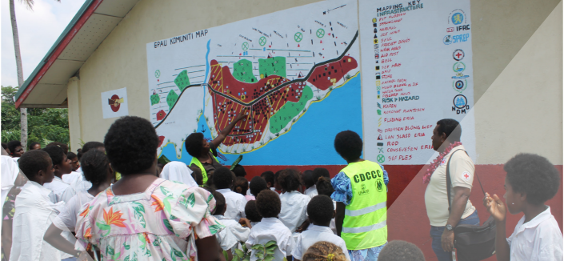
Community Early Warning Systems
Impressive examples: CEWS in Vanuatu and 7 Pacific countries
Notes:
Conducted in the Pacific, the so called ‘FINPAC’ project pilots aimed to develop a model to better link community, national and provincial early warning systems.
In the eight countries, partnerships for project oversight and implementation were formed between NMSs, NDMOs, Red Cross National Societies, provincial authorities and communities. These multi-organization teams worked together to design, conduct and review participatory workshops, training and exercises to identify community priorities and knowledge related to disasters.
Example of successful outcome in this project:
For example, in the Solomon Islands, over an eight-month period, Solomon Islands Meteorological Service (SIMS), Solomon Islands Red Cross Society (SIRCS), the Solomon Islands National Disaster Management Office (SINDMO) and local media worked together to develop a low-cost, low-tech community early warning system for floods. The resulting community early warning system uses a truck horn as a siren and a solar-powered three-colour emergency light (red, yellow and blue) based on the colour coding used by standard (SINDMO) national alerts. conducted This is linked to a low cost low technology solar powered flood siren system. While the light system is designed to monitor and warn the community of flood events, it can also be used for other hazards such as tropical cyclones and tsunamis. A simulation exercise was to test the community early warning system and the community’s response procedures. In the week following, a real tsunami warning was activated for Solomon Islands and all community members were evacuated following their com- munity response and evacuation plan.
Information was used to develop a low tech, low cost community early warning systems and community disaster response plan unique to the respective community. You can read about the CEWS, eg see the village of Epau in Vanuatu in the examples for this section.
See complete case study here: https://media.ifrc.org/ifrc/wp-content/uploads/sites/5/2018/06/CaseStudy1_Pacific-EWEA-Final.pdf

Slide 17
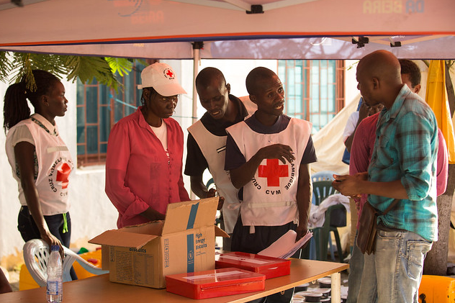
Preparedness for Effective Response (PER)
Photo: Danish Red Cross
This refers to the measures and actions taken by a National Society to prepare for, respond to, recover from and reduce the effects of disasters and crises.
.
Photo: Mozambique Red Cross, cyclone Idaï 2019
Notes:
Although the concept of preparedness for response is primary focused on responding effectively to disasters, it has a strong focus on anticipatory planning done in the long term through annual planning, seasonal and short term planning. EWEA, EWS and Forecast-based Financing are components within the wider disaster preparedness plans, with the caveat that forecast-based actions can also include mitigation and prevention measures.
“Preparedness is the knowledge and capacities developed by governments, response and recovery organizations, communities and individuals to effectively anticipate, respond to and recover from the impacts of likely, imminent or current disasters.
Annotation: Preparedness action is carried out within the context of disaster risk management and aims to build the capacities needed to efficiently manage all types of emergencies and achieve orderly transitions from response to sustained recovery.
Preparedness is based on a sound analysis of disaster risks and good linkages with early warning systems, and includes such activities as contingency planning, the stockpiling of equipment and supplies, the development of arrangements for coordination, evacuation and public information, and associated training and field exercises. These must be supported by formal institutional, legal and budgetary capacities. The related term “readiness” describes the ability to quickly and appropriately respond when required. “ UNISDR terminology
A preparedness plan establishes arrangements in advance to enable timely, effective and appropriate responses to specific potential hazardous events or emerging disaster situations that might threaten society or the environment.
Important to enable effective response: a new unified and common RCRC movement approach for NS response capacity enhancement is being implemented around the world: called “PREPAREDNESS FOR EFFECTIVE RESPONSE (PER) APPROACH”
PER Objectives:
To support the NSs to take the lead in assessing, planning, implementing and monitoring their preparedness for response status and actions. To enable the membership to achieve a common approach to NS Preparedness for Effective Response.
Please note: if your National Society has not engaged yet in this process, contact your IFRC regional cluster representative.
IMPORTANT LINK TO FbF: The preparedness for response (PER) approach is also an opportunity for the activation of a Forecast-based Financing mechanism. When a National Society is well prepared to respond to a disaster, it implicitly shows that it is prepared to do forecast-based actions. Actions that not only include preparedness for response., byt that have an strong focus on prevention and mitigation of risks. Therefore, investment in PER is an investment in FbF and viceversa.

Slide 18
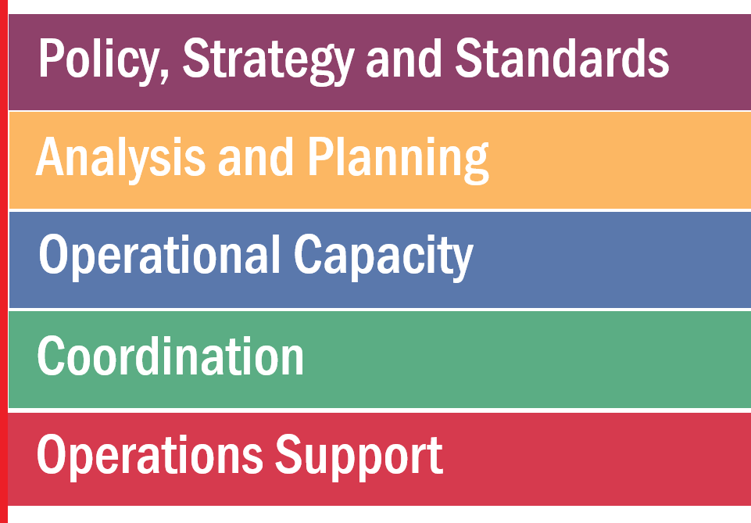
What does it mean to be PER ready?
A National Society develops a strategic work plan and implements key actions to improve their response effectiveness.
The key areas for capacity strengthening are:
Photo: Danish Red Cross
Notes:
Early Warning Early Action is a key component of a well prepared National Society and key condition of success to be able not only to respond effectively AND to act early before a disaster happens to prevent and/or mitigate risks.

Slide 19
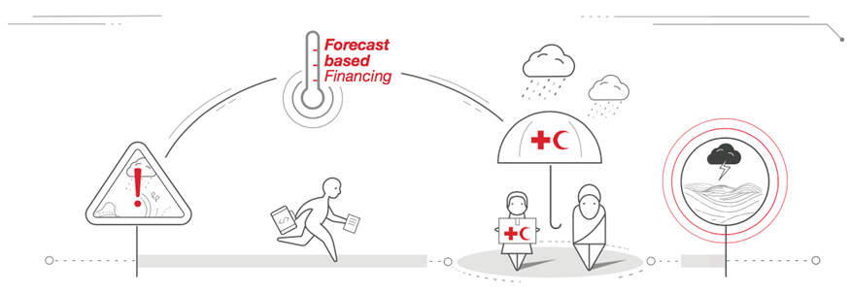
What is Forecast-based Financing?
A mechanism that uses climate and weather forecasts and risk analysis to enable the timely disbursement of funds to implement early actions before a potential disaster happens.
Notes:
Forecast-based Financing could be implemented in conjunction with EWS or it can be developed separately, when there are no EWSs.
FbF tackles extreme weather events, while EWS can also apply for annually recurring events. EWS within the RCRC applies to all kind of hazards (Hydro-Meteorological, Biological and Man-made) while FbF at the moment only tackles hydro-meteorological hazards.
More details about FbF will be shared in the next modules.
FbF video explanation: https://vimeo.com/153078147

Slide 20
Moving from Early Action to Forecast based financing
2018
The German Government supports the IFRC to create the first anticipatory funding mechanisms for Forecast-based Action.
2013
2009
“Early action is an investment for the future. But this seems to be a lesson that individuals, donors, countries and some of the ‘humanitarian community’ have yet to learn. There is still too much resistance to change…” World Disaster Report 2009
The German Government supports the first Forecast based Finance pilots in Uganda and Togo
Notes:
During the last 10 years there has been a remarkable evolution in the way how the RCRC does EWEA.
National and Community-based EWS have been strengthened across the world and new financial mechanisms like the Forecast-based Action (FBA) by the Disaster Relief Emergency Fund (DREF) have been created. FbA by the DREF makes it possible for National Societies to develop Forecast-based Financing (FbF) mechanisms to have access to funding to implement early actions in the window of time between a forecast and a potential disaster.
Optional Visual Aid:
You could project the FbA by DREF fund video https://youtu.be/FcuKUBihHVI
In the two other Presentations in this module, there is much more indepth information about FbF.

Slide 21
Example of Forecast-based Financing
Photo: Stefanie Lux/ German Red Cross
Notes:
After the FbF explanation, present this video if possible: https://youtu.be/XUSSUuRW0HQ
In 2017, Bangladesh experienced the worst floods in recent decades.
Based on a forecast and pre-defined trigger level, an FbF pilot project distributed an unconditional cash grant of BDT 5,000 (US$ 60 equivalent) to poor households in highly vulnerable, flood-prone communities in the Brahmaputra river basin before an early flood peak in July 2017.
The evaluation collected data from about 200 FbF beneficiaries and 200 comparison households who were equally vulnerable and lived in nearby communities that were similarly affected by the flood.
Thanks to the “quasi-experimental” research design (comparing experiences from FbF intervention communities with those in comparable communities who did not get early, forecast-based assistance), the evaluation was able to identify the differential benefits of FbF.
The full evaluation report is available here: https://docs.google.com/document/d/1Rms2aWkdSyS0jUx-KqwOMXlVDlKGQERBbFsqOyBhqtE/edit
The picture: Alefa Katum is a beneficiary of the cash transfer based on Forecast. She described the FbF intervention as something very important to avoid losing her livelihoods and food.
There will be a detailed explanation about FbF in the section 3 of this EWEA module.

Slide 22
How can early warning early action support national systems:
Social Protection
What is Social Protection?
Set of policies and programs aimed at preventing or protecting all people against poverty, vulnerability, and social exclusion (for instance social safety nets: cash transfers, cash for work)
E.g. In 2005, Ethiopia started the Productive Safety Net Program, which has reached 7.9 million people facing chronic food insecurity. They receive food or cash transfers either as direct assistance or in return for community work.
Notes:
Social Protection and EWEA
But first, what is social protection?
Social protection policies and programmes are part of a national system intending to reduce poverty, deprivation and vulnerability by helping people manage various risks. This system includes Social safety nets such as cash transfers, cash-for-work programmes and temporary employment programmes, school feeding programmes (Social protection also includes other systems like pensions; health, unemployment benefits, etc, but here we focus on social safety nets)
Safety nets are of direct relevance to humanitarian practitioners, including the Red Cross Movement. Activities like cash transfers, cash-for-work and school feeding programmes are part of the usual activities in emergency response. In a social protection setting, the focus is on a national system, with multi-year funding (eventually by domestic funds) to manage both short and long term risks in a predictable and financially sustainable manner.
After a shock, social protection benefits help people absorb the impacts by providing direct support to affected populations, and preventing some of their negative consequences. Mexico’s conditional cash transfer programme, Progresa, allowed poor families affected by a drought to keep their children in school. Social protection can also provide benefits that help people anticipate and prevent disasters before they happen, by taking early action and by improving incomes and livelihoods, more on the next slide. If you want to know more about social protection in general, see the “7 things to know about managing climate risk through social protection”
A National Society can get engaged in social protection at the local level and at the national level to make sure social protection programmes are linked to early warning and early action.
See the separate module on social protection for climate risk management - forthcoming - link to be added

Slide 23
Social protection can serve as a platform
for early warning early action
SP programmes are already involved in disaster response: Brazil’s Bolsa Família provided in-kind and cash benefits to 162,000 families in 279 municipalities, within 10 days of the 2011 floods, using its registry of beneficiaries and identification cards
Social protection programs can:
Help better identify and target vulnerable people
Enable rapid action, using existing structure to channel support for early action, such as cash transfers
Support accountability to affected populations
Notes:
The faster support reaches people affected by an extreme event, the less likely they are to resort to negative coping strategies.
An existing social protection system can use its administrative structure to channel support for early action, such as cash transfers to vulnerable people in anticipation of a disaster or as early as possible after it.
Adding targeting criteria based on exposure to climate or natural hazard allows programmes to distinguish people who need support on a long-term basis from those needing it on a temporary basis as a result of a climate shock. By considering climate risk in social protection programmes, it is possible to identify those at risk in advance of a shock and provide transitory support to them when they need it.
Coordination between humanitarian and social protection programmes can enable more timely support, especially when contingency funding and a clear plan of action are in place before the emergency.
By being part of existing, long term government programs, beneficiaries might be able to have more accountability from the system itself.
SP programmes are already involved in disaster response:
- In Ethiopia, the government manages a contingency budget comprising 20% of the annual Productive Safety Net Programme budget. The separate fund of $160 million (USD), based on a donor commitment, establishes a Risk Financing Mechanism for the mobilisation of up to $80 million (USD) each year in additional funds in case of a crisis. These mechanisms are based on an existing early warning system that monitors the situation and triggers the release of funds.
- Bolsa Família provided in-kind and cash benefits to 162,000 families in 279 municipalities, within 10 days of the 2011 floods that ravaged Brazil 2011. It used its registry of beneficiaries and identification cards to identify affected families, disbursing payments through
the programme’s banking arrangements with branches of the Caixa Econômica Federal. The fact that the programme was already in place sped up the delivery of assistance

Slide 24
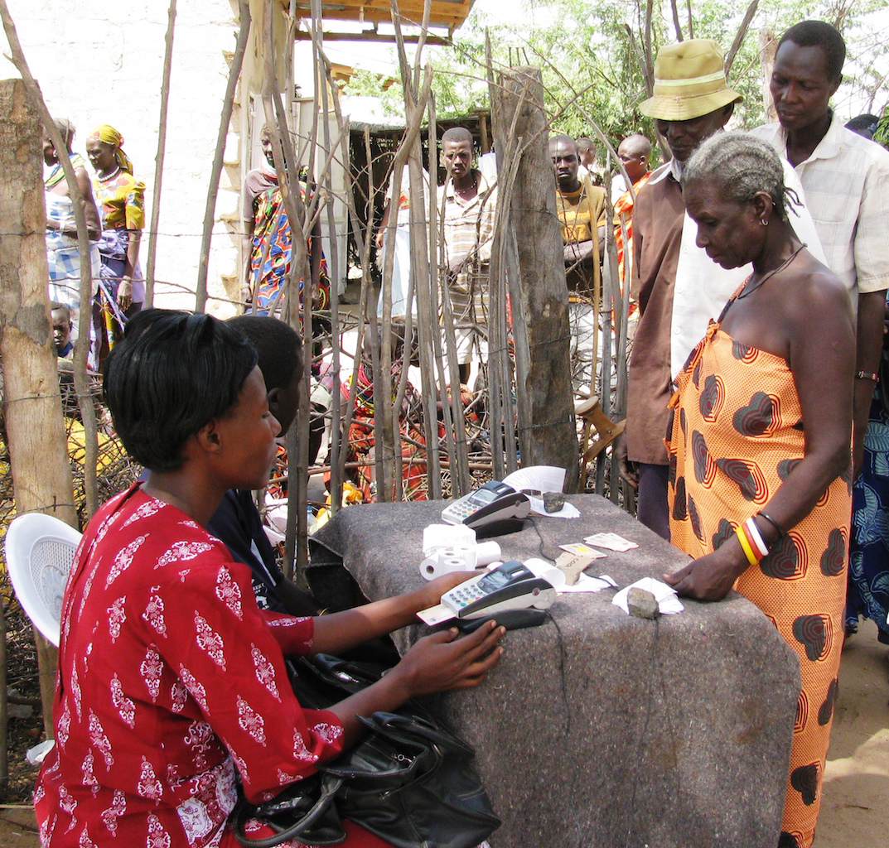
Social Protection and the Red Cross
The Hunger Safety Net Programme in Kenya has been designed to scale up in advance of climate shocks, such as drought.
In 2017, the Kenya Red Cross aligned its emergency response to drought to maximize coverage of affected people, collaborating closely with the HSNP.
Photo: FSD Kenya - HSNP
Notes:
Social protection is of direct relevance to humanitarian practitioners. Activities like cash transfers, cash-for-work and school feeding programmes are part of the usual activities in emergency response. The difference between those activities in an emergency and a social protection is that social protection consists of a system to manage both short and long term risks as part of a long-term country-driven strategy to move people out of poverty and increase resilience.
Social protection programmes are often designed to serve a community over the long term. The Red Cross also focuses on building resilience at community level
In many countries, the Red Cross, as auxiliary to the government, plays a role in the delivery of social protection programmes - for instance, delivering cash transfers. In places where climatic shocks are recurrent, programmes can be designed to scale up when needed to provide early action based on early warning information.
In the case of emergencies, the Red Cross may coordinate with existing programmes . For instance, in Kenya, The Hunger Safety Net Programme in Kenya has been designed to scale up in advance of climate shocks, such as drought. The programme can reach up to an additional 180,000 households with periodic emergency payments. Emergency beneficiaries receive a single month’s transfer (i.e. KES 2,700) if the area where they live is deemed to be subject to severe or extreme drought in any given month. The expectation is that the assistance will support households to reduce extreme hunger and vulnerability, by smoothing their consumption and avoiding negative coping strategies, such as the sale of productive assets.
The Kenya Red Cross emergency response to the 2017 drought took into account:
The value of cash transfer to every household was calculated based on percentage of average food basket cost which closely matched transfers value provided by other programmes such as Hunger Safety Net Programme (HSNP),
KRCS has held a number of consultative meetings with HSNP Team to coordinate beneficiary selection
KRCS made use of their targeting data (from online database) to ensure that there was no double targeting and to target households that are currently not included in Hunger Safety Net Programme
In some case, the Red Cross has played a role in setting up social protection policies that are climate-sensitive such as in the case of Malawi:
In 2017, the Malawi Government revised the national social protection policy programme.
The Malawi Red Cross alongside several other partners participated in the yearlong policy review process and focused on improving climate-sensitive SP and aligning it with humanitarian action.
As a result, climate-sensitive social protection became a national priority, and efforts will be taken forward in a more coherent and impactful way.
An important element of climate-sensitive social protection is linking with existing food security EWEA systems
Malawi Red Cross will continue to be engaged in the delivery and implementation of the national cash transfer program, which will now have stronger linkages with humanitarian response.

Slide 25
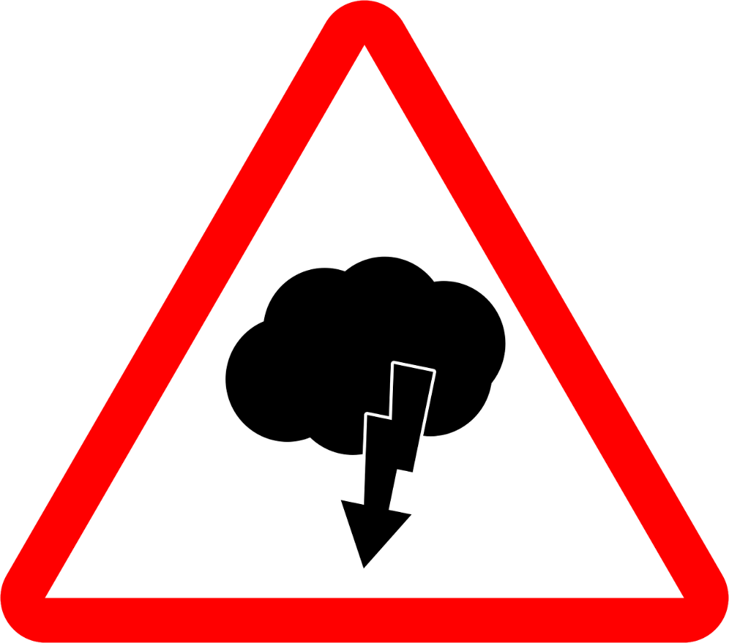
Conclusions
National Societies have a number of ways to incorporate early warning early action into their strategic and operational plans and programming.
Different National Societies will have different early warning early action entry points.
These will depend on the climate and disaster risk context of the country and the National Society capacity.
IFRC and Climate Centre support National Societies with identification of early warning early action entry points and with the implementation steps.
Notes:
Note to the facilitator – for this topic, different games are most successful to provide concrete understanding of making use of climate information for humanitarian decisions
See the games section for this module.

